Slide 1
Early Start | Duration | Early Finish
Early Start
Late Start | Float | Late Finish
Appendix B - Schedule, Annex C - PERT Chart
K | Negotiate Scope & Cisco Onboarding w/ Manufacturer
T | Training
D | Device Monitoring and Onboarding
N | Network Monitoring
P | Patching Compliance
S | Supplier Engagement
R | Risk Assessment
D1
D2
D3
N2
N3
N4
P1
P2
P3
P4
P5
N1
R1
R2
R3
K1
S1
S2
S3
S5
S4
S6
T1
T2
T3
K2

Slide 2
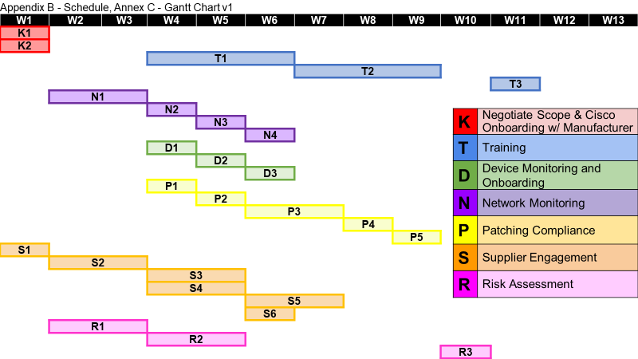

Slide 3
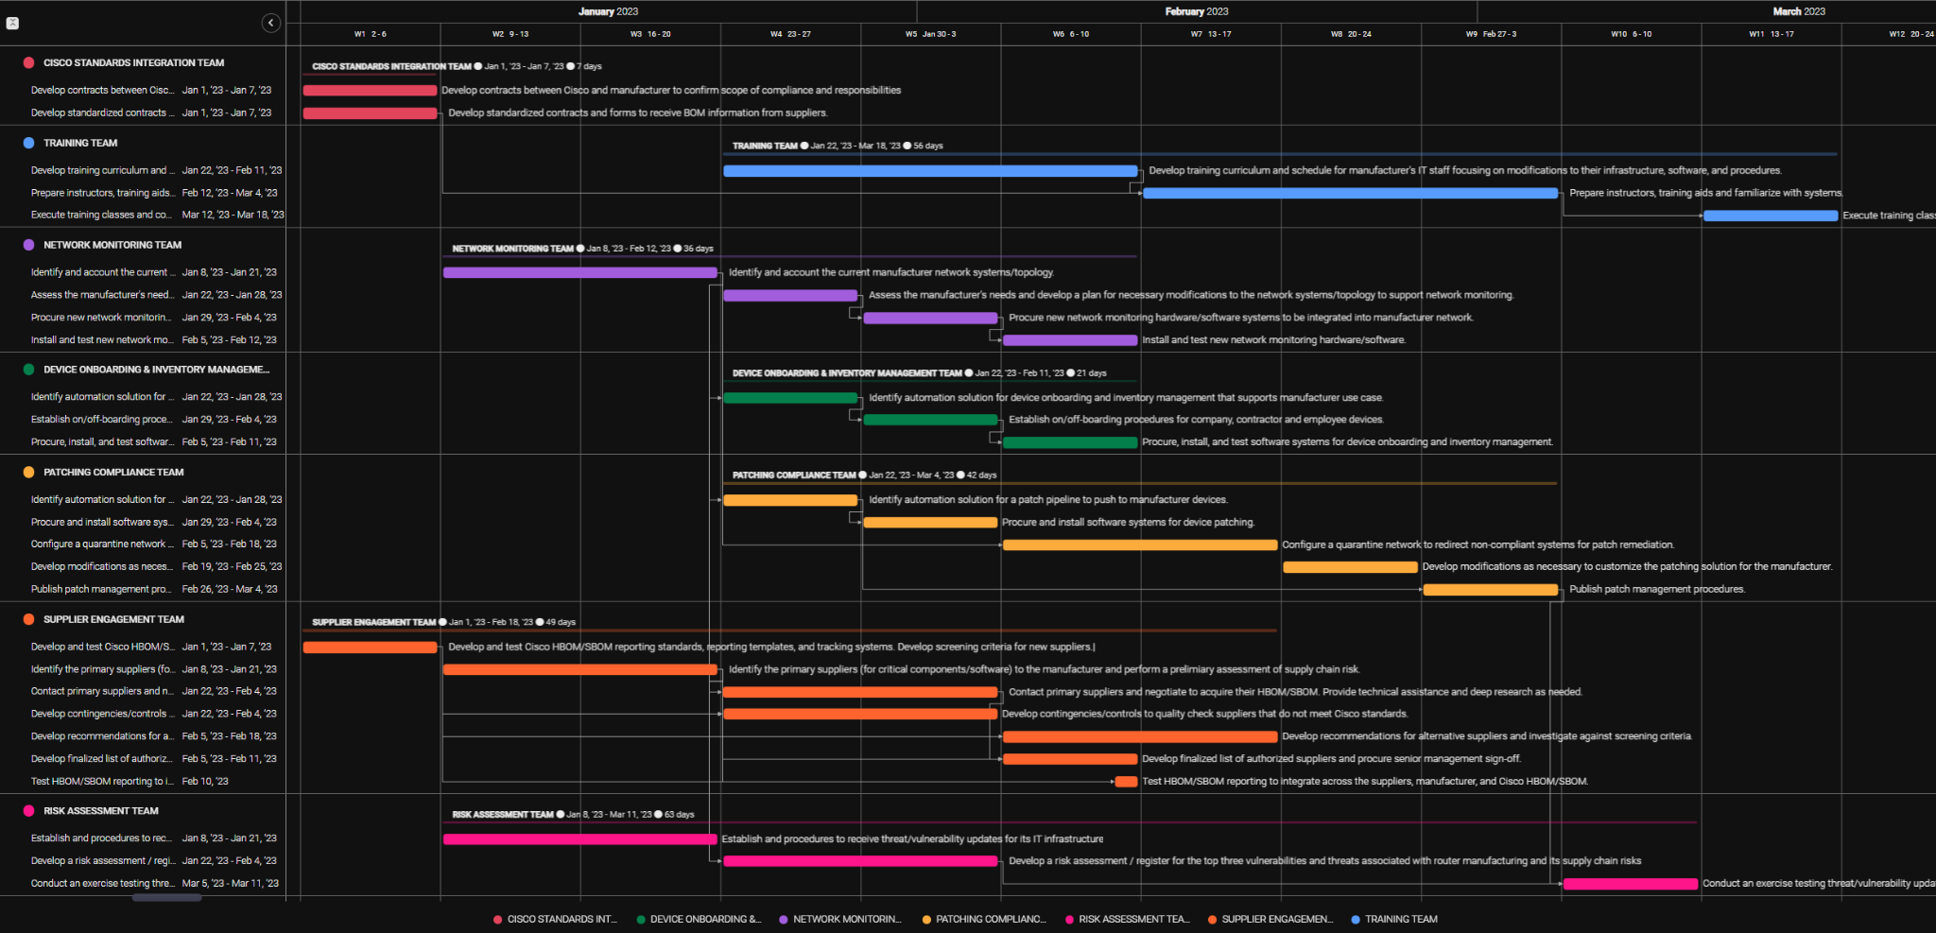
Appendix B - Schedule, Annex C - Gantt Chart, v2
Notes:
SHAWN

